Slide 1
Language Detection: Deep learning in Practice
Contributors-

Slide 2
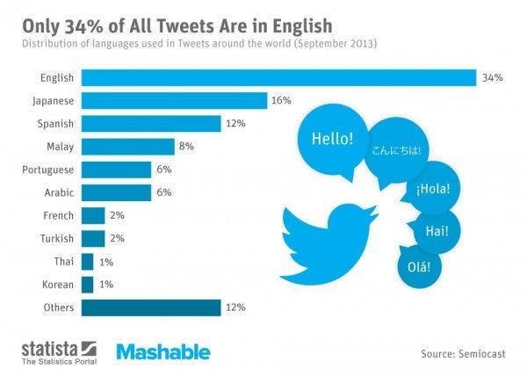

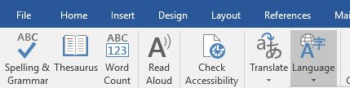
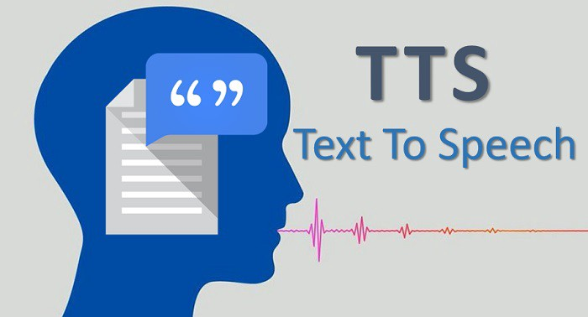

Overview of the project
English
German
Spanish
Italian
French

Slide 3
Business model

Slide 4
Project development life cycle
Show visually
Data collection
Data storage
Tell data understanding here
Data collection – from Wikipedia pages of 5 languages
Data

Slide 5
Data collection
Wikimedia dumps
WikiExtractor
Stored uncleaned files in local
Processed and stored cleaned files in local

Slide 6
Project pipeline
Data collection
Data Cleaning
Normalization
Augmentation
Training
Optimization
Testing
Plan for deployment

Slide 7
Comparison with existing model

Slide 8
Architecture of the Deep neural network
Embedding Layer
LSTM Layer
Dropout
LSTM Layer
Dropout
Dense Layer

Slide 9
Optimization of model
Tuning here

Slide 10
Challenges faced
Challenges
Limitation
Disambiguation of languages originating from same root language (Lexical similarity).
Regular classifiers based on word frequency only are inadequate in making a correct prediction.
Computationally expensive

Slide 11
Requirements to run the model
Python 3.6
Jupyter Notebook
Numpy
Pandas
Scikit-Learn
TensorFlow 1.15

Slide 12
Thank you

